Slide 1
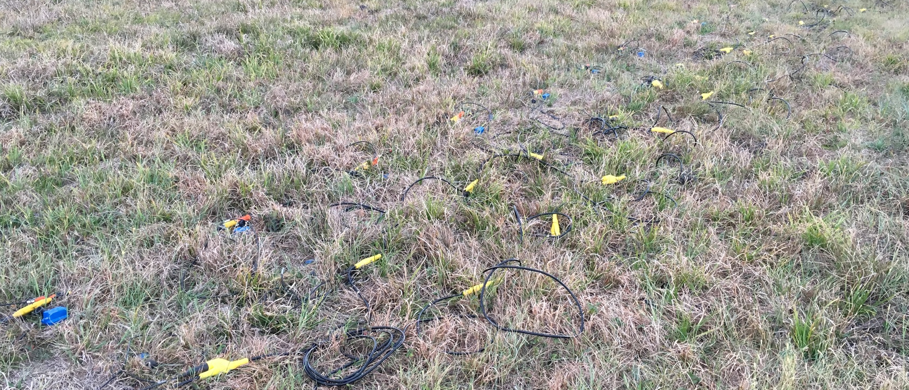
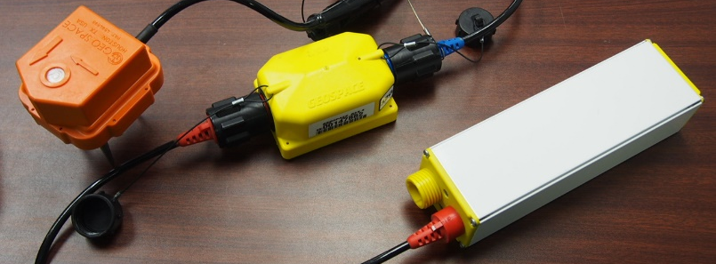
a.
Traditional Cabled Geophones
b.
Battery
Seismic Recorder Unit
Geophone

